Slide 1
Are you ready for GDPR (RODO)?
GDPR (RODO) last minute
Date: 24 May 2018, 09:00 - 11:30
Venue: DAGO Centrum, Rondo ONZ 1 (2nd floor), Warsaw
RSVP: by 21 May, E: Paulina.Gancwol@dzp.pl
The cost of participation is 150 zł

Slide 2
GDPR (RODO) last minute
Agenda
09:00 – 09:15 Registration of attendants, morning coffee
09:15 – 10:00 GDPR (RODO) last minute – DZP
Is it too late (25 May 2018)?
What is the implementation process of the GDPR (RODO)?
What is a must and what can be done?
Where are the greatest risks?
Will foreign HQ help?
10:00 – 10:45 How technology can help achieve GDPR (RODOO) compliance? – Microsoft
Cloud computing and shared responsibility – how does it work for GDPR (RODO)?
Easy and fast solutions – is it possible?
The day after – what can we expect?
10:45 – 11:30 Q&A
Attendance is possible once DZP has confirmed receipt of your application. The number of places is limited, so a maximum of two persons from each firm may attend.

Slide 3
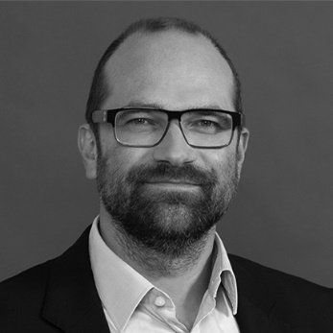
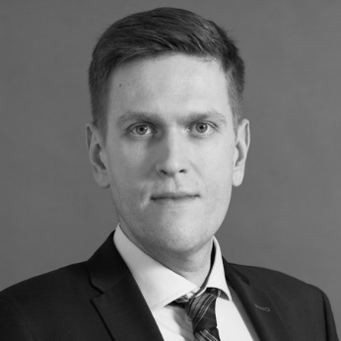
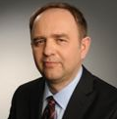
GDPR (RODO) last minute
Speakers
Bartosz Marcinkowski, Partner, Head of Data Privacy Team, DZP
Michał Kluska, Senior Associate, DZP
Michał Jaworski, Technology Director, Microsoft
Expert in personal data protection, including international advisory in this field. He is also a doctor of law in this field. Author of numerous publications and is a lecturer in Poland and abroad. He has spoken at conferences in, e.g. London, Madrid, Valencia, Chicago, Vancouver, Columbus, Copenhagen, Hamburg and Frankfurt.
Specialises in personal data protection, new technology, Internet, online services, and advertising and e-commerce law. He participates in projects involving the comprehensive implementation of GDPR. He often leads workshops during conferences and training.
Working for Microsoft since 1994, Member of the Board of Microsoft sp. z o.o. since 2013. Chairman of Polish IT and Telecommunication Chamber of Commerce Council. Member of Council of National Centre of Research and Development (2012-16). Member of “Polska 2020” foresight project team. Awarded with Silver Cross of Merit (2012), the highest civilian award in Poland. Regular columnist in “IT Professional” and “IT w Administracji”.

